Slide 1
CS4104 Applied Machine Learning
Reinforcement Learning

Slide 2
Reinforcement learning
In the case of the agent acts on its environment, it receives some evaluation of its action (reinforcement), but is not told of which action is the correct one to achieve its goal

Slide 3
What is Reinforcement Learning?
Reinforcement learning requires a learning agent to learn from the environment rather than being guided what to do.
With the lack of designated guidelines and uncertain chances of matching the right actions, the reinforcement learning is indeed a trial-and-error learning.
A numerical reward is used as a reinforcement signal to encourage the learning agent to successfully keep matching the expected outcomes.
The learning agents will be guided by the problems they have encountered in past experiences and try to avoid them.

Slide 4

Uses for Reinforcement Learning
Control Systems
Robotics
Game Development
Automation
Advertisement
E-commerce (e.g., Amazon)
Industrial Automation (e.g., Stocks)

Slide 5
Reinforcement learning
Task
Learn how to behave successfully to achieve a goal while interacting with an external environment
Learn via experiences!
Examples
Game playing: player knows whether it win or lose, but not know how to move at each step
Control: a traffic system can measure the delay of cars, but not know how to decrease it.

Slide 6



Paradigm
Supervised Learning
Unsupervised Learning
Reinforcement Learning
Objective
Classification
Regression
Inference
Generation
Prediction
Control
Applications
Notes:
In reinforcement learning the goal is to learn a policy, which gives us the action given

Slide 7
Reinforcement Learning
Advantages
Disadvantages
No need for large labeled data sets
Avoid human error and bias
Can outperform humans
Used to solve complex problems
Error is corrected as there are occurrences
Learns from experience
Trial/Error can be time consuming and costly
Not preferred for solving methods
Needs a lot of data and computation especially when the environment has a lot of states

Slide 8






Prediction
$$x$$
$$y$$
Control
$$u$$
$$y$$
$$x$$
Notes:
Prediction: finding the likely output given the input
Control is a little different, now we have to find a control given only the observation (and a reward signal)
So can we use any of the tricks we learned for prediction in control?

Slide 9
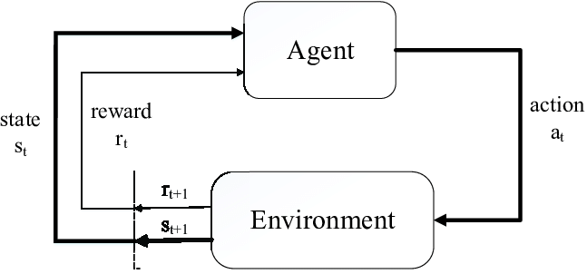
Terminology
Agent: entity that is performing the actions to accumulate reward
Policy: decision making the agent employs to decide
Reward: immediate return given to the agent when it performs a task
Environment: scenario that an agent must face
Value: long term return with discount
State: current situation returned by the environment

Slide 10
RL model
Each percept(e) is enough to determine the State(the state is accessible)
The agent can decompose the Reward component from a percept.
The agent task: to find a optimal policy, mapping states to actions, that maximize long-run measure of the reinforcement
Think of reinforcement as reward
Can be modeled as MDP model!

Slide 11
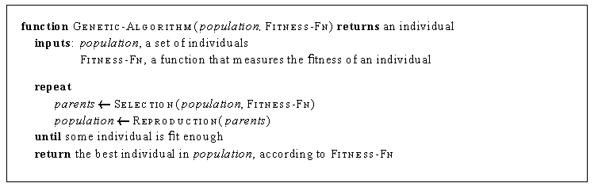
Genetic algorithm and Evolutionary programming
Start with a set of individuals
Apply selection and reproduction operators to “evolve” an individual that is successful (measured by a fitness function)

Slide 12
Genetic algorithm and Evolutionary programming
Imagine the individuals as agent functions
Fitness function as performance measure or reward function
No attempt made to learn the relationship the rewards and actions taken by an agent
Simply searches directly in the individual space to find one that maximizes the fitness functions

Slide 13
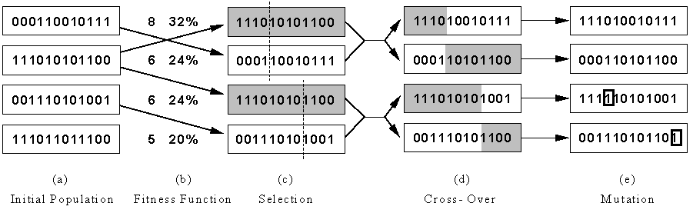
Genetic algorithm and Evolutionary programming
Represent an individual as a binary string(each bit of the string is called a gene)
Selection works like this: if individual X scores twice as high as Y on the fitness function, then X is twice likely to be selected for reproduction than Y is
Reproduction is accomplished by cross-over and mutation

Slide 14




Markov Decision Processes
Transition function
Reward function
State space
Action space
Notes:
Markov – only previous state matters
Decision – agent takes actions, and those decisions have consequences
Process – there is some transition function
Transition function is sometimes called the dynamics of the system
Reward function can in general depend on both the state and action, but often it’s only related to the state
Goal: maximize overall reward

Slide 15
Review of Markov Decision Process (MDP) model
MDP model <S,T,A,R>
S– set of states
A– set of actions
T(s,a,s’) = P(s’|s,a)– the probability of transition from s to s’ given action a
R(s,a)– the expected reward for taking action a in state s
Agent
State
Action
Reward
Environment
a₀
a1
a2
s₀
s₁
s2
s3
r₀
r1
r2

Slide 16
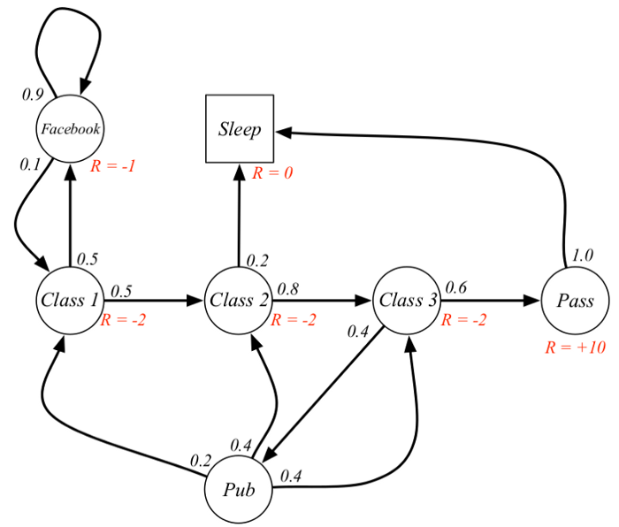

Markov Decision Process
How the environment is declared
The goal is to follow the path with the highest sum of rewards
Low discount factor, immediate reward
High discount factor, long term reward

Slide 17
Discount Factor
We want to be greedy but not impulsive
Implicitly takes uncertainty in dynamics into account
Mathematically: γ<1 allows infinite horizon returns
Return

Slide 18
Solving an MDP
Objective:
Goal:

Slide 19
Function Approximation
Model:
Training data:
Loss function:
where
Notes:
Allows continuous state spaces
Where’s the deep in “deep RL”
Whats with this other Q?
At the beginning of training our Q function will be really bad, so the updates will be bad, but each update is moving in the right direction, so overall we’re moving in the right direction
Take the derivative of loss wrt Q -> gives you q learning update -> shows the mse loss for params is equivalent to the tabular setting of updating the q values

Slide 20
Model based v.s.Model free approaches
But, we don’t know anything about the environment model—the transition function T(s,a,s’)
Here comes two approaches
Model based approach RL:
learn the model, and use it to derive the optimal policy.
e.g Adaptive dynamic learning(ADP) approach
Model free approach RL:
derive the optimal policy without learning the model.
e.g LMS and Temporal difference approach
Which one is better?

Slide 21
Passive v.s. Active learning
Passive learning
Active learning
The agent imply watches the world going by and tries to learn the utilities of being in various states
The agent not simply watches, but also acts

Slide 22
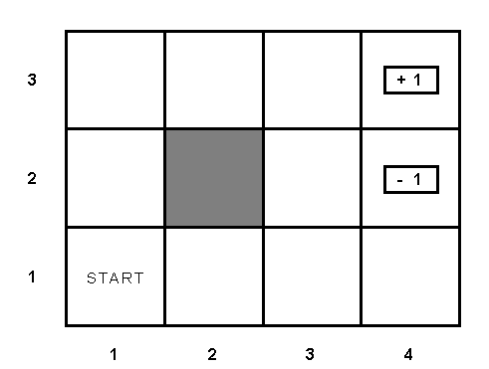
Example environment

Slide 23
Passive learning scenario
The agent see the the sequences of state transitions and associate rewards
The environment generates state transitions and the agent perceive them
e.g (1,1) →(1,2) →(1,3) →(2,3) →(3,3) →(4,3)[+1]
(1,1)→(1,2) →(1,3) →(1,2) →(1,3) →(1,2) →(1,1) →(2,1) →(3,1) →(4,1) →(4,2)[-1]
Key idea: updating the utility value using the given training sequences.

Slide 24
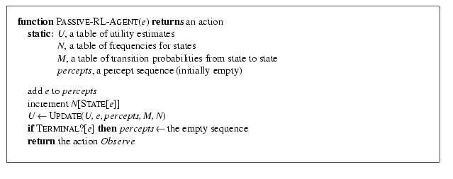
Passive leaning scenario

Slide 25
LMS updating
Reward to go of a state
the sum of the rewards from that state until a terminal state is reached
Key: use observed reward to go of the state as the direct evidence of the actual expected utility of that state
Learning utility function directly from sequence example

Slide 26
LMS updating
function LMS-UPDATE (U, e, percepts, M, N ) return an updated U
if TERMINAL?[e] then
{ reward-to-go ← 0
for each ei in percepts (starting from end) do
s = STATE[ei]
reward-to-go ← reward-to-go + REWARS[ei]
U[s] = RUNNING-AVERAGE (U[s], reward-to-go, N[s])
end
}
function RUNNING-AVERAGE (U[s], reward-to-go, N[s] )
U[s] = [ U[s] * (N[s] – 1) + reward-to-go ] / N[s]

Slide 27
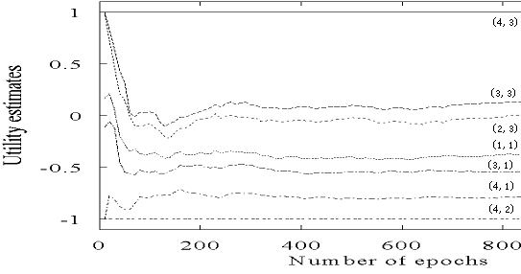
LMS updating algorithm in passive learning
Drawback:
The actual utility of a state is constrained to be probability- weighted average of its successor’s utilities.
Converge very slowly to correct utilities values (requires a lot of sequences)
for our example, >1000!

Slide 28
Temporal difference method in passive learning
TD(0) key idea:
adjust the estimated utility value of the current state based on its immediately reward and the estimated value of the next state.
The updating rule
is the learning rate parameter
Only when is a function that decreases as the number of times a state has been visited increased, then can U(s)converge to the correct value.

Slide 29
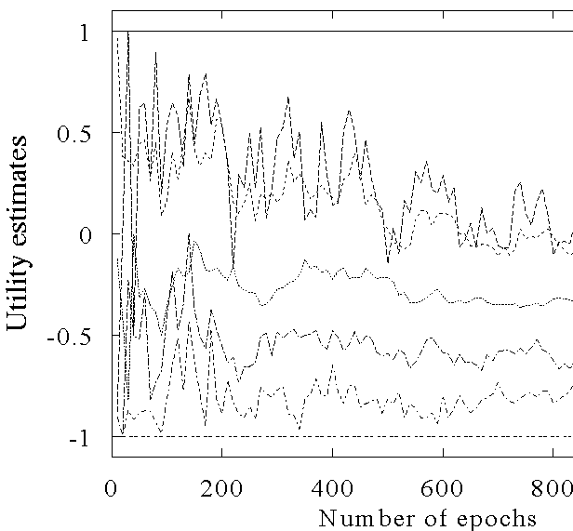
The TD learning curve
(4,3)
(2,3)
(2,2)
(1,1)
(3,1)
(4,1)
(4,2)

Slide 30
Adaptive dynamic programming(ADP) in passive learning
Different with LMS and TD method(model free approaches)
ADP is a model based approach!
The updating rule for passive learning
However, in an unknown environment, T is not given, the agent must learn T itself by experiences with the environment.
How to learn T?

Slide 31
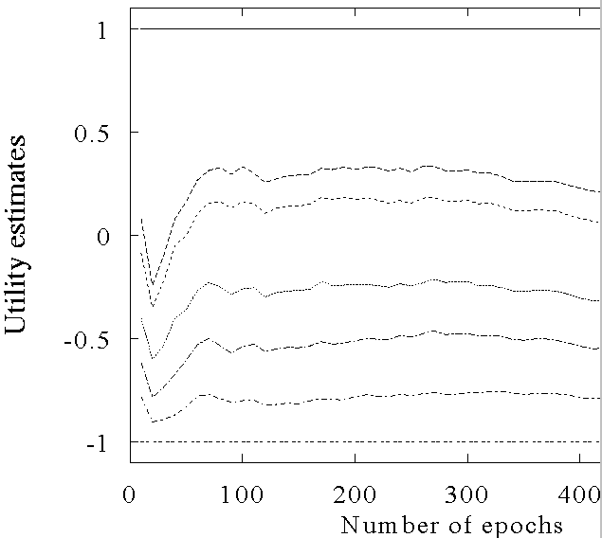
ADP learning curves
(4,3)
(3,3)
(2,3)
(1,1)
(3,1)
(4,1)
(4,2)

Slide 32
Active learning
An active agent must consider
what actions to take?
what their outcomes maybe(both on learning and receiving the rewards in the long run)?
Update utility equation
Rule to chose action

Slide 33
Active ADP algorithm
For each s, initialize U(s) , T(s,a,s’) and R(s,a)
Initialize s to current state that is perceived
Loop forever
{
Select an action a and execute it (using current model R and T) using
Receive immediate reward r and observe the new state s’
Using the transition tuple <s,a,s’,r> to update model R and T (see further)
For all the sate s, update U(s) using the updating rule
s = s’
}

Slide 34
How to learn model?
Use the transition tuple <s, a, s’, r> to learn T(s,a,s’) and R(s,a). That’s supervised learning!
Since the agent can get every transition (s, a, s’,r) directly, so take (s,a)/s’ as an input/output example of the transition probability function T.
Different techniques in the supervised learning(see further reading for detail)
Use r and T(s,a,s’) to learn R(s,a)

Slide 35
ADP approach pros and cons
Pros:
ADP algorithm converges far faster than LMS and Temporal learning. That is because it use the information from the the model of the environment.
Cons:
Intractable for large state space
In each step, update U for all states
Improve this by prioritized-sweeping (see further reading for detail)

Slide 36
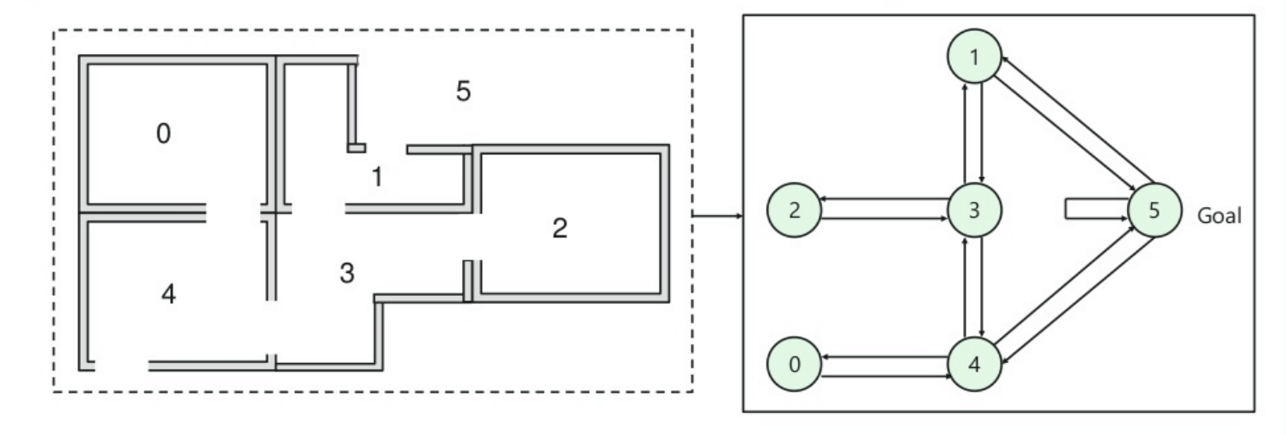
Q-learning
Value-based method of supplying information to inform which action an agent should take.
’Q’ means quality which represents the gain of a future reward given a situation.
Seeks the best course of action to take and maximizes the total reward.

Slide 37
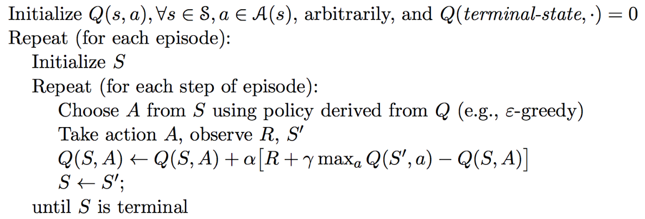
Q Learning
Notes:
Without knowing the transition function

Slide 38
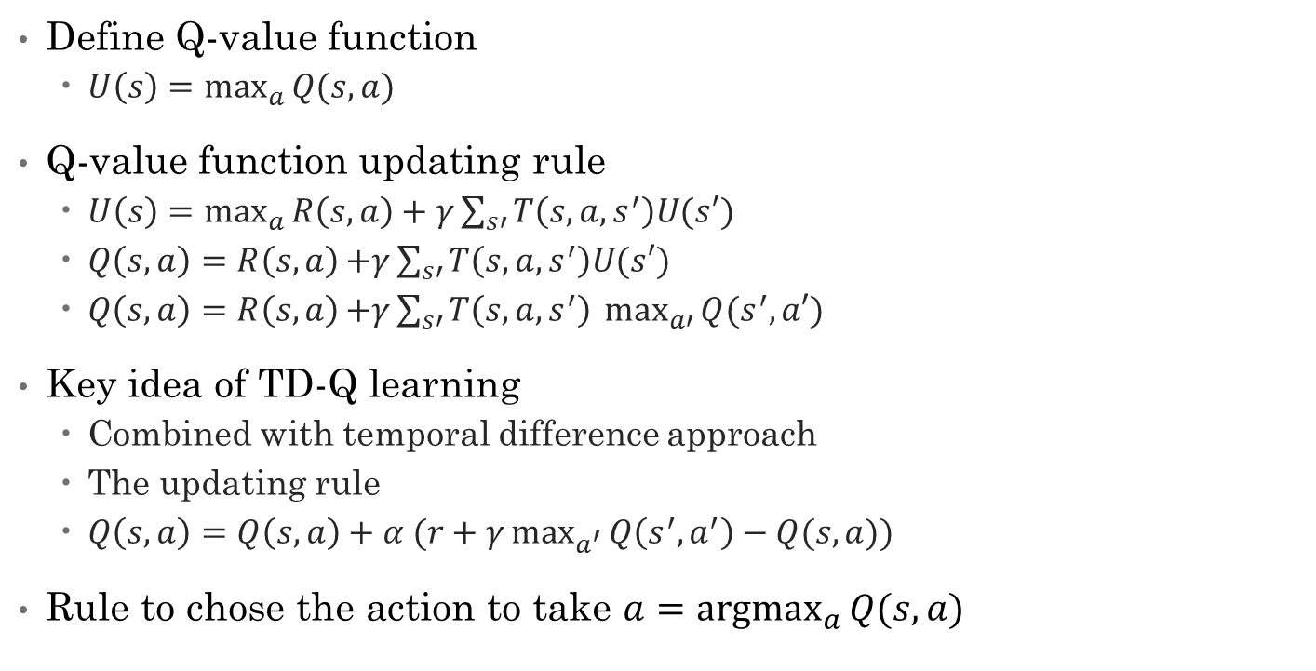
Model free method– TD-Q learning
Define Q-value function
$U\left(s\right)=\max_{a}{Q(s,a)}$
Q-value function updating rule
$U\left(s\right)=\max_{a}{R\left(s,a\right)+γ}\sum_{s′}{T\left(s,a,s^{′}\right)U(s′)}$
$Q\left(s,a\right)=R\left(s,a\right){+γ}\sum_{s′}{T\left(s,a,s^{′}\right)U(s′)}$
$Q\left(s,a\right)=R\left(s,a\right){+γ}\sum_{s′}{T\left(s,a,s^{′}\right) \max_{a′}{Q(s^{′},a′)}}$
Key idea of TD-Q learning
Combined with temporal difference approach
The updating rule
$Q\left(s,a\right)=Q\left(s,a\right)+α (r+γ\max_{a^{′}}{Q\left(s^{′},a^{′}\right)}−Q(s,a))$
Rule to chose the action to take $a=\underset{a}{argmax}{Q(s,a)}$

Slide 39
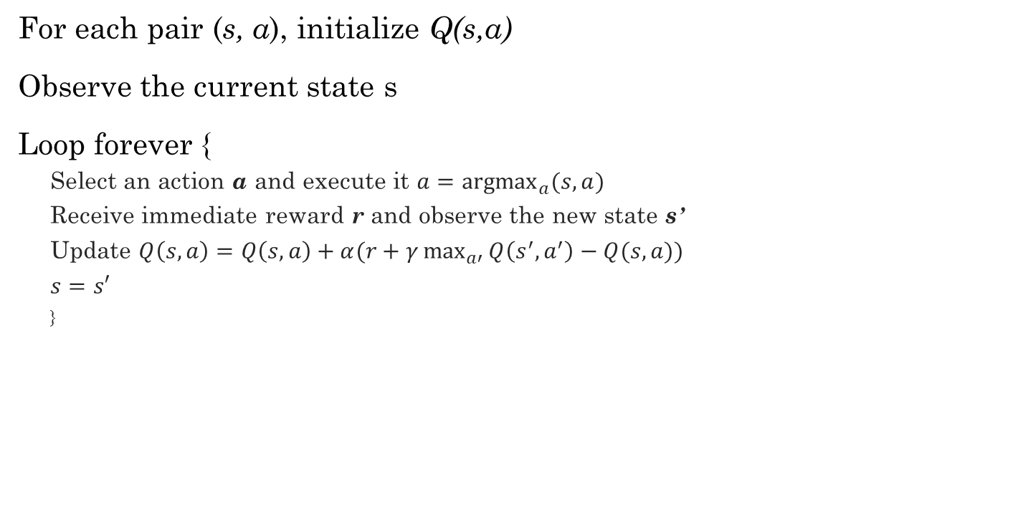
TD-Q learning agent algorithm
For each pair (s, a), initialize Q(s,a)
Observe the current state s
Loop forever {
Select an action a and execute it $a=\underset{a}{argmax}{(s,a)}$
Receive immediate reward r and observe the new state s’
Update $Q\left(s,a\right)=Q\left(s,a\right)+α(r+γ\max_{a′}{Q\left(s^{′},a^{′}\right)−Q(s,a)})$
$s=s′$
}

Slide 40
Exploration problem in Active learning
An action has two kinds of outcome
Gain rewards on the current experience tuple (s,a,s’)
Affect the percepts received, and hence the ability of the agent to learn

Slide 41
Exploration problem in Active learning
A trade off when choosing action between
its immediately good(reflected in its current utility estimates using the what we have learned)
its long term good(exploring more about the environment help it to behave optimally in the long run)
Two extreme approaches
“wacky”approach: acts randomly, in the hope that it will eventually explore the entire environment.
“greedy”approach: acts to maximize its utility using current model estimate
See Figure 20.10
Just like human in the real world! People need to decide between
Continuing in a comfortable existence
Or striking out into the unknown in the hopes of discovering a new and better life

Slide 42
Exploration problem in Active learning
One kind of solution: the agent should be more wacky when it has little idea of the environment, and more greedy when it has a model that is close to being correct
In a given state, the agent should give some weight to actions that it has not tried very often.
While tend to avoid actions that are believed to be of low utility
Implemented by exploration function f(u,n):
assigning a higher utility estimate to relatively unexplored action state pairs
Chang the updating rule of value function to
U+ denote the optimistic estimate of the utility

Slide 43
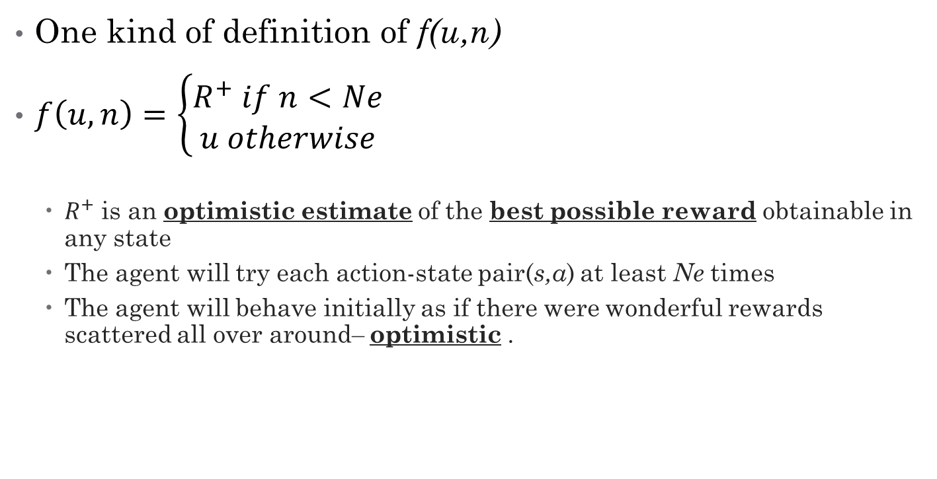
Exploration problem in Active learning
One kind of definition of f(u,n)
$f\left(u,n\right)=\left\{\begin{matrix}R^{+} if n<Ne \\ u otherwise\end{matrix}\right.$
$R^{+}$ is an optimistic estimate of the best possible reward obtainable in any state
The agent will try each action-state pair(s,a) at least Ne times
The agent will behave initially as if there were wonderful rewards scattered all over around– optimistic .

Slide 44
Generalization in Reinforcement Learning
So far we assumed that all the functions learned by the agent are (U, T, R,Q) are tabular forms—
i.e.. It is possible to enumerate state and action spaces.
Use generalization techniques to deal with large state or action space.
Function approximation techniques

Slide 45
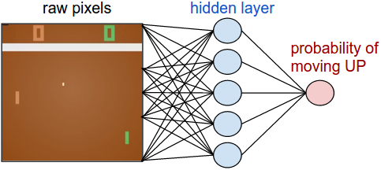
Example: Atari Games

Slide 46
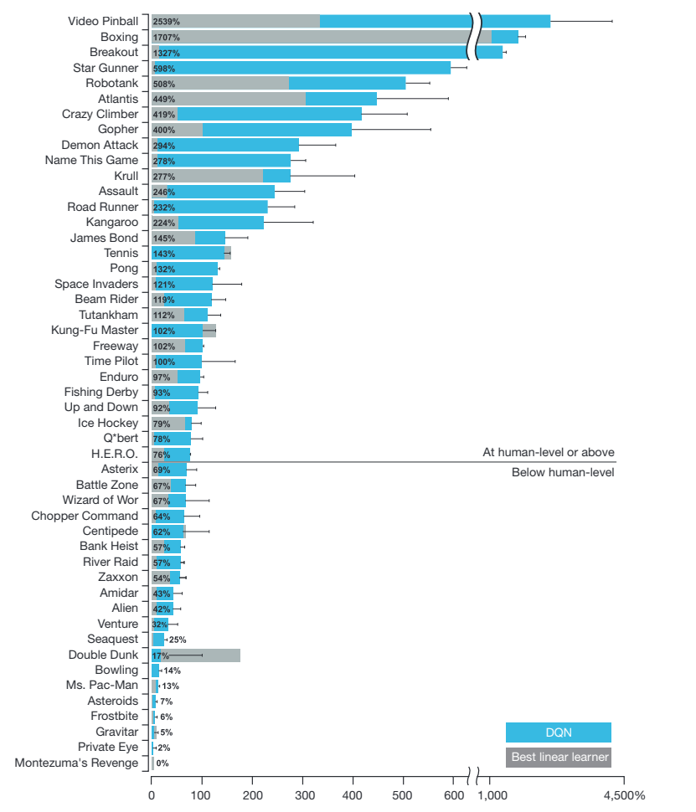
State: Raw Pixels
Actions: Valid Moves
Reward: Game Score

Slide 47
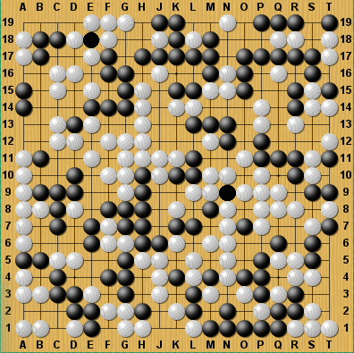
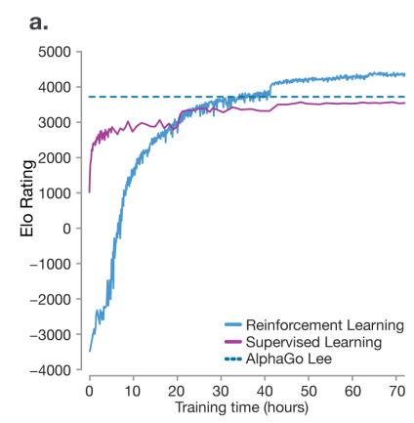
Alpha Go
Learning how to beat humans at ‘hard’ games (search space too big)
Far surpasses (Human) Supervised learning
Algorithm learned to outplay humans at chess in 24 hours
State: Board State
Actions: Valid Moves
Reward: Win or Lose

Slide 48
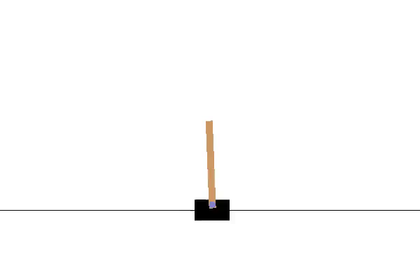
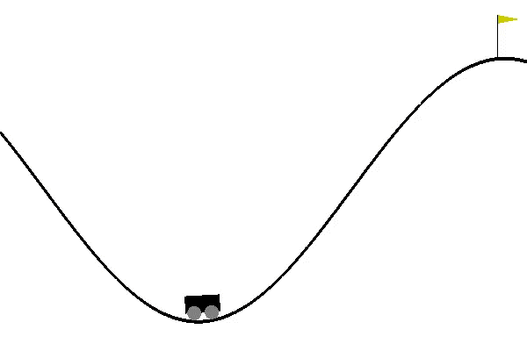
Gym – toolkit for reinforcement learning
CartPole
import gym
env = gym.make('CartPole-v0')
import random
import QLearning # Your implementation goes here...
import GymSupport
trainingIterations = 20000
qlearner = QLearning.QLearning(<Parameters>)
for trialNumber in range(trainingIterations):
observation = env.reset()
reward = 0
for i in range(300):
env.render() # Comment out to make much faster...
currentState = ObservationToStateSpace(observation)
action = qlearner.GetAction(currentState, <Parameters>)
oldState = ObservationToStateSpace(observation) # Old state = current
observation, reward, isDone, info = env.step(action)
newState = ObservationToStateSpace(observation)
qlearner.ObserveAction(oldState, action, newState, reward, …)
if isDone:
if(trialNumber%1000) == 0:
print(trialNumber, i, reward)
break
# Now you have a policy in qlearner – use it...
Reward +1 per step the pole remains up
MountainCar
Reward 200 at flag -1 per step
https://gym.openai.com/docs/

Slide 49
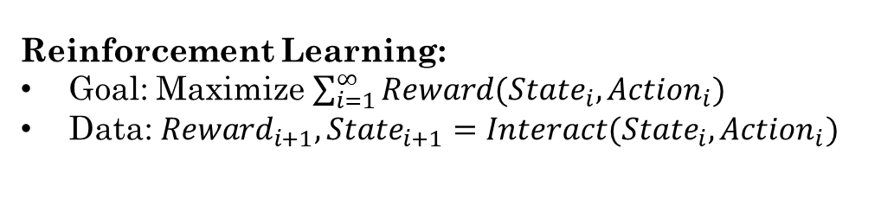
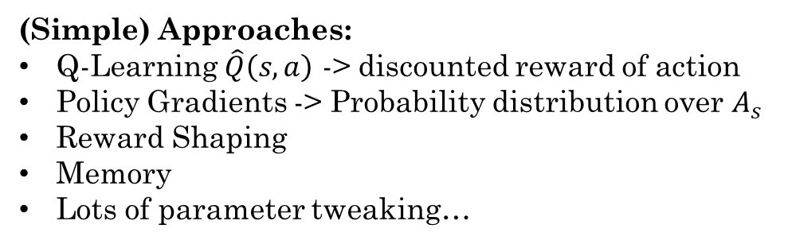
Summary
Reinforcement Learning:
Goal: Maximize $\sum_{i=1}^{∞}{Reward({{State}_{i}, Action}_{i})}$
Data: ${Reward}_{i+1}, {State}_{i+1}=Interact({State}_{i},{Action}_{i})$
Agent
Reward
State
Action
Many (awesome) recent successes:
Robotics
Surpassing humans at difficult games
Doing it with (essentially) zero human knowledge
Environment
(Simple) Approaches:
Q-Learning $\hat{Q}\left(s,a\right)$ -> discounted reward of action
Policy Gradients -> Probability distribution over $A_{s}$
Reward Shaping
Memory
Lots of parameter tweaking…
Challenges:
When the episode can end without reward
When there is a ‘narrow’ path to reward
When there are many states and actions

